Slide 1
Fuzzy Implementation of a Neuro-Fuzzy System with Improved PSO Learning
Cihan Karakazu, Fuat Karakaya, Mehmet Ali Cavuslu
And now in Powerpoint form by: Harrison Marcks

Slide 2
Keywords/Acronyms/Definitions
NFS :- Neuro-Fuzzy System
PSO :- Particle Swarm Optimization
iPSO :- improved PSO
ANFIS :- Artificial Neuro-Fuzzy Inference System
FPGA :- Field programmable Gate Array
NF :- Nero-Fuzzy
MF :- Membership Function
Membership function :- A curve that defines how each point in an input is mapped to a membership value
Fuzzy system :- true or false do not exist so much as “partially” true concepts. Easier to understand for human operators compared to Genetic Algorithms and Neural Nets, yet performs just as well in some cases.

Slide 3
Introduction and Motivation
NFS is a technique for system control, identification/modelling, and prediction and is trained by using gradients
However, these systems require complex gradient computation and often get stuck at local minima
PSO is inspired by the behaviour of animal swarms (such as birds flocking to a feeding spot).
FPGAs are capable of parallel processing and have gained increased importance as a preferable platform for Neural, fuzzy and NF applications
The paper demonstrates the first hardware implementation of this (NFS) system with metaheuristic learning ability on an FPGA.
Another presented novelty is that it requires no memory nor multiplier usage when used with Gaussian MF.
Improved efficiency not by reliability but in far fewer hardware resources
Notes:
PSO: is used for statistical global search and has before been used for neuro fuzzy and NN to solve nonlinear problems

Slide 4
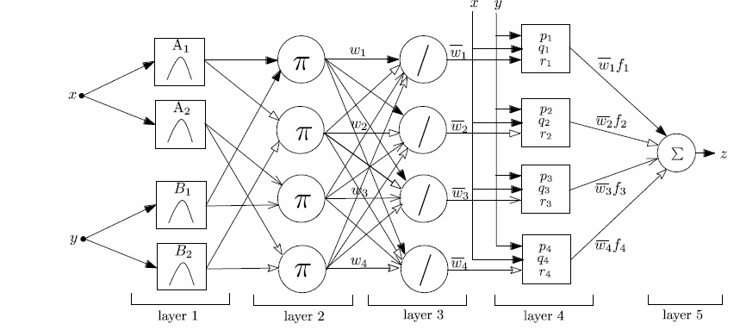
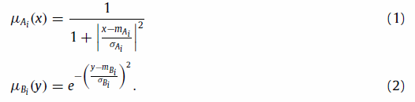

Model
First Layer (EQ 1 or EQ 2)
2 inputs
Four rules ( Membership functions)
Second Layer
Nodes perform algebraic product of T-Norm to determine strength of a rule firing
Third Layer (EQ 3)
Computer different weight rule firings receiving all rule firings by being fully connected to layer 2. Normalised firing Strength.
Fourth Layer (EQ 3)
Contributions of each rule are computed (As compared to the original input)
Fifth layer (EQ 3)
Weight average de-fuzzification is performed and a crisp output is obtained

Slide 5
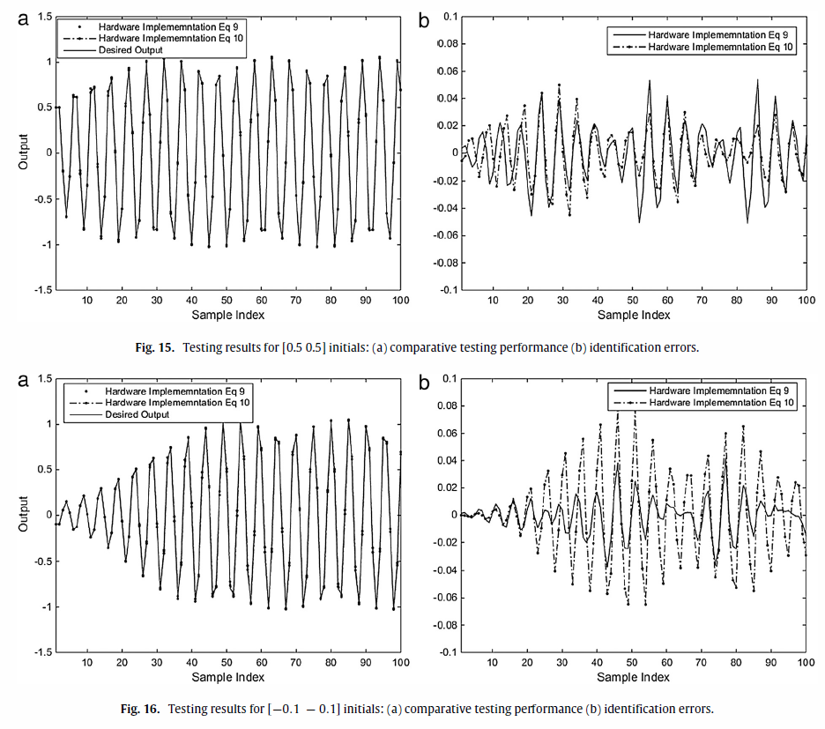
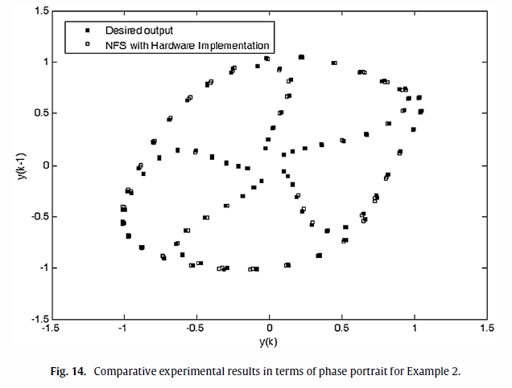
Results and determining
Implementation used for license plate recognition; to determine whether a region of an image includes the license plate. It did pretty good.

Slide 6
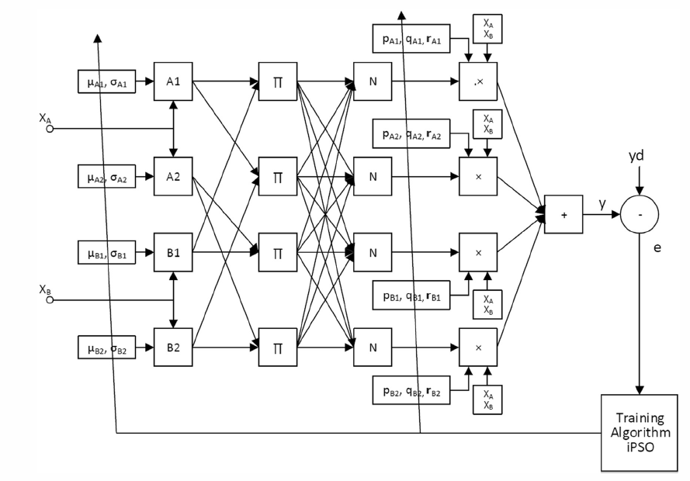
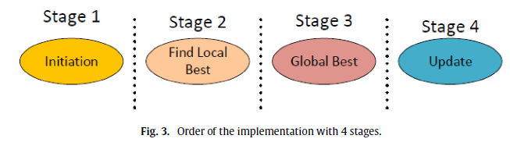
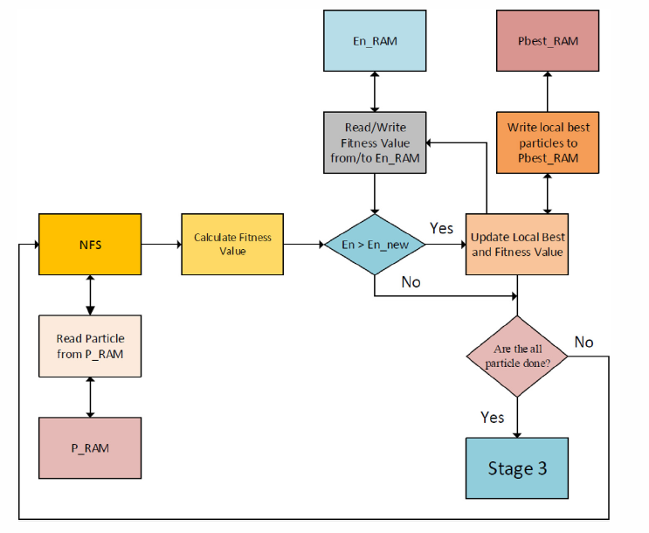
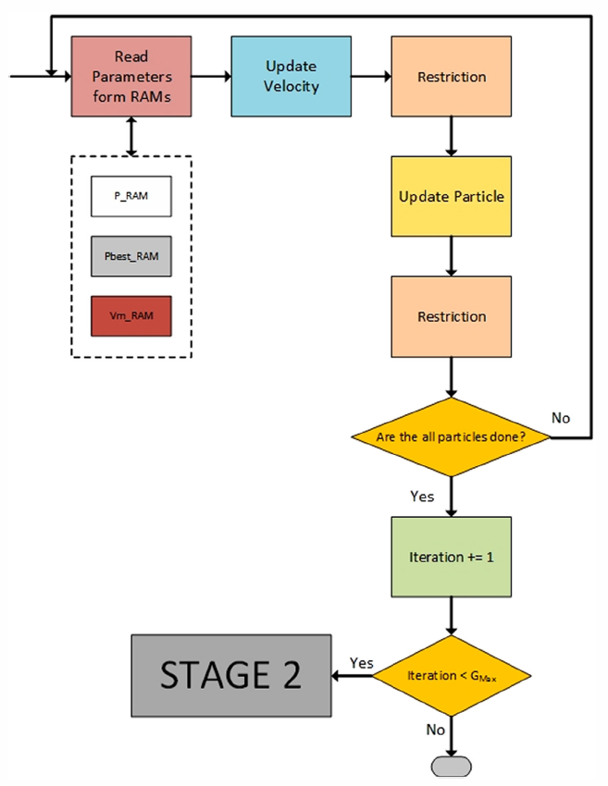
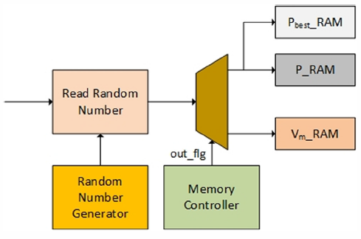
Parallelisation
Stage 1
Stage 3
Stage 2 components

Slide 7
Parallelisation
Everything bounded by the red lines is a separate thread
Each column (or layer) can be computed separately to every toher column (though must be performed in sequence)
Each thread in layer 3 and 5, however, both depend on every thread in the previous layer having finished.
Layer 2 depends on two threads (one for each used equation) from the previous layer also finishing.

Slide 8
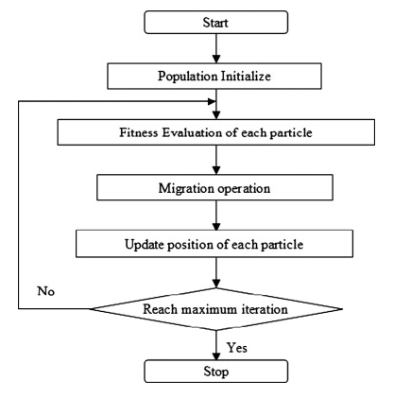
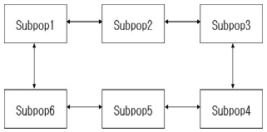
Parallelisation
Kim, Mun, Kim, HoPark (2011), Optimal power system operation using parallel processing system and PSO algorithm in International Journal of Electrical Power & Energy Systems, Volume 33, Issue 8, October 2011, Pages 1457-1461
PSO parallelisation is rarely done due to a potential loss of it’s convergence properties. However due to the large amount of computation time PSO takes, parallelisation is worth it.
The entire population is divided into sub-populations that share the burden of calucalation

Slide 9
QA

